Slide 1

Culture, Language and Business Systems Analysis
INFOSYS 3810

Slide 2

Who am I …
Richard A Navarro … Founders’ Professor, UMSL CoBA
BS Aeronautical Engineering, MS Mechanical Engineering, MS Computer Engineering, Masters of Business Administration
And
I retired from the Boeing Corporation in 2006 after 42 years
  Chief Electronics Engineer
  Director, Information Technology
  Corporate Business Systems Architect
And
I have taught in China, Germany, Thailand and Namibia

Slide 3
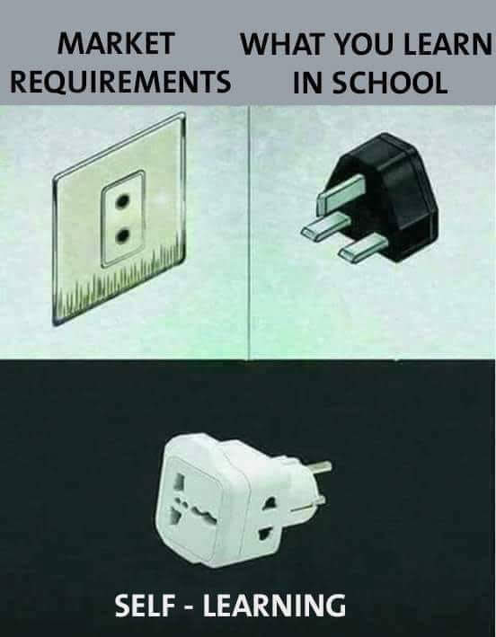
Systems Analysis … Why Do We Care?
Customer Needs
One Design
A Better Design

Slide 4
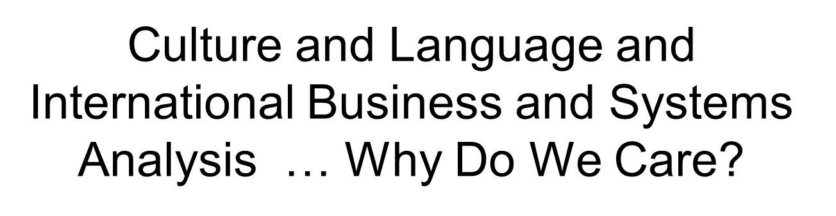
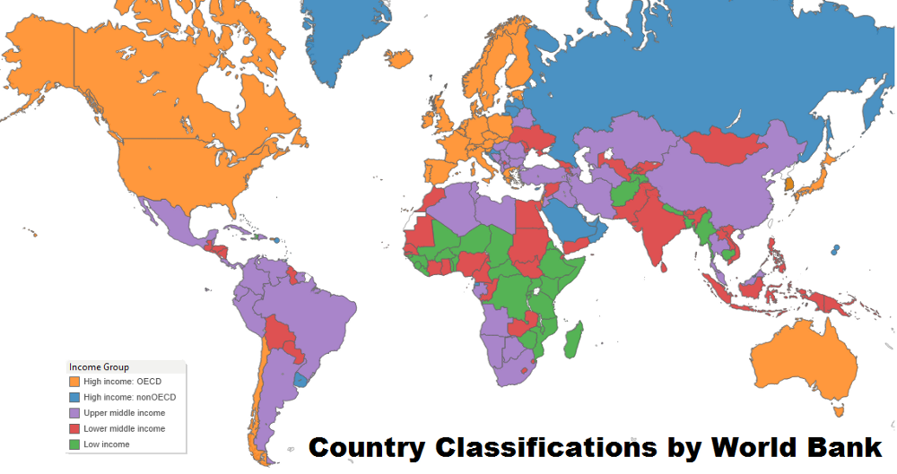

Slide 5
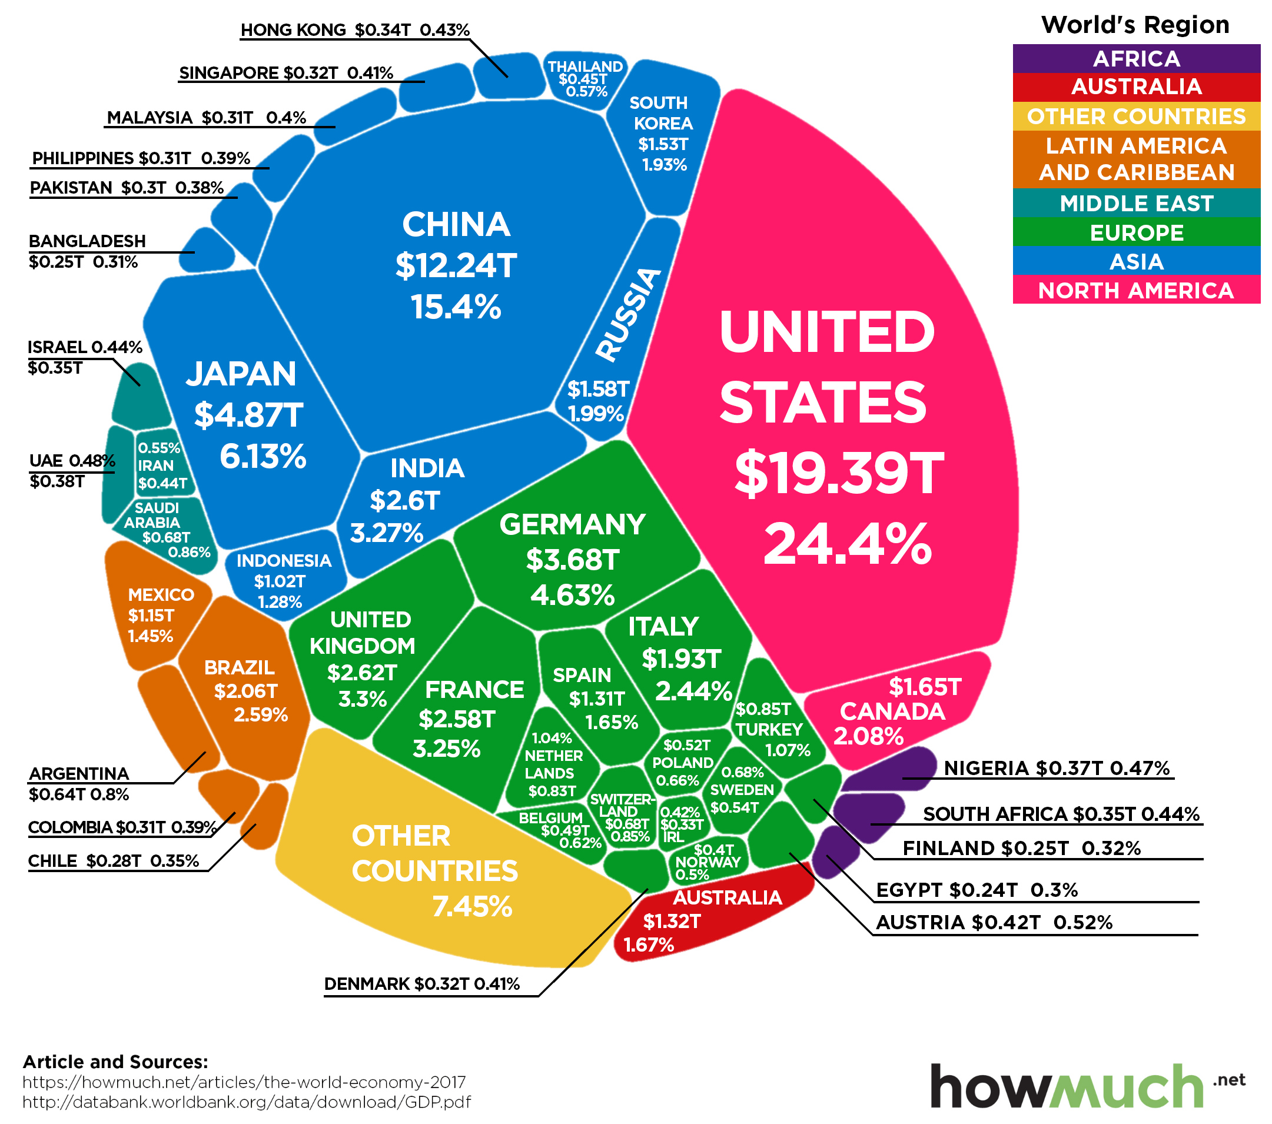
Culture and Language and International Business and Systems Analysis … Why Do We Care?

Slide 6
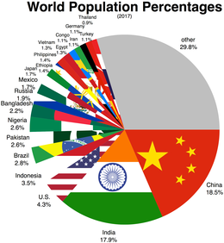

Slide 7
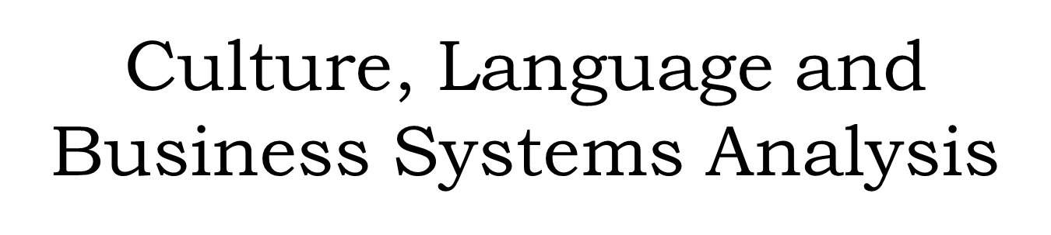
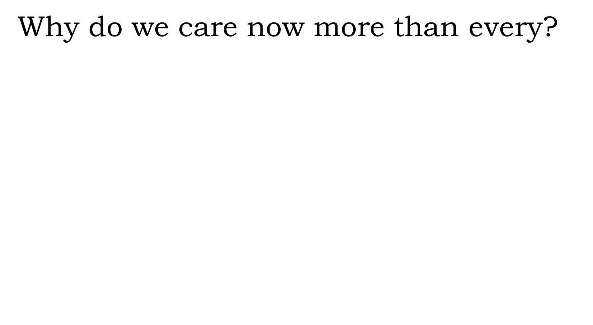
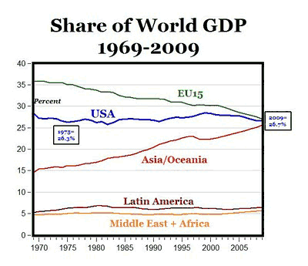
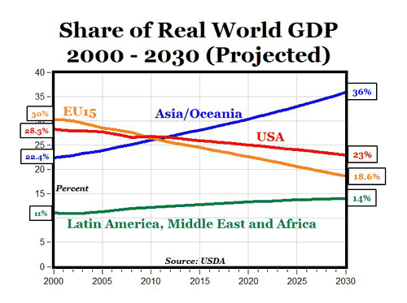

Slide 8
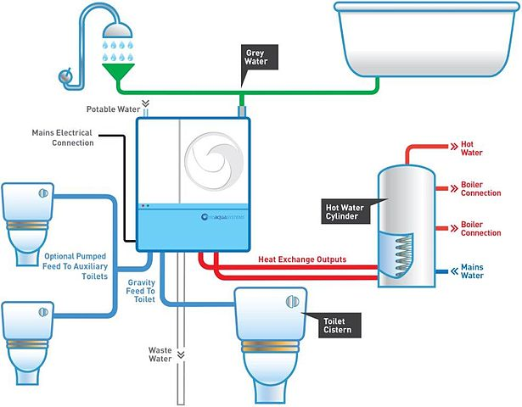
Culture, Language and Business Systems Analysis
Context
System … a collection of things that work together to achieve some goal or purpose.

Slide 9

Context, Cont.
Systems Analysis … the act, process, or profession of studying an activity (as a procedure, a business, or a physiological function) typically by formal means in order to define its goals or purposes and to discover operations and procedures for accomplishing them most efficiently..

Slide 10
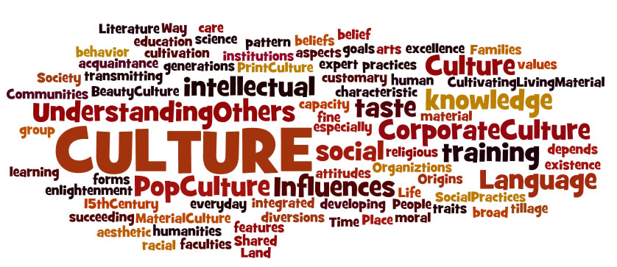
Context, Cont.
A Culture … an integrated pattern of human knowledge, belief, and behavior or set of shared attitudes, values, goals, and practices that characterizes an institution, organization or group

Slide 11
Context, Cont.
Social Scientists have long studied linguistics, cultures, cognition and behavior and the relationships among them
The Business community has long studied business systems, strategies, economics, accounting and finance, et.al.

Slide 12
Context, Cont.
But …
Ought these two views be separate and distinct?

Slide 13
Context, Cont.
No … Language and culture must be considered by business
No … Language and culture must be considered when information professional and business analysts do their work
No … In the requirements elicitation phase, perhaps the most critical part of business systems development, language and cultural impacts MUST be considered

Slide 14
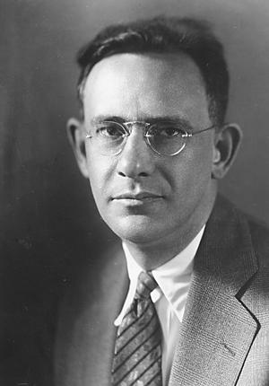
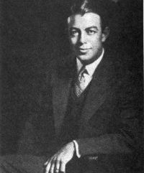
Language
Sapir noted some languages are fundamentally different from others
Spoiler Alert
Liguistic Relativeity in general and the
Sapir Whorf hypnosis in particular is still hotly contested … What do you think?
“We see and hear and otherwise experience very largely as we do because the language habits of our community predispose certain choices of interpretation”
Whorf hypothesized that the fundamental differences among languages drive fundamental differences in thought
“We cannot talk at all except by subscribing to the organization and classification of data which the agreement decrees.”

Slide 15
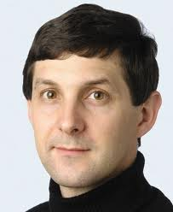
Language DOES Matter
Deutscher asserts that language can impact thought
“The influence of the mother tongue … is felt in areas of thought such as memory and perception (and) in practical skills.”

Slide 16

Language Does Matter
  “From a postmodern perspective all reality is a linguistic construction”
  VLNavarro

Slide 17

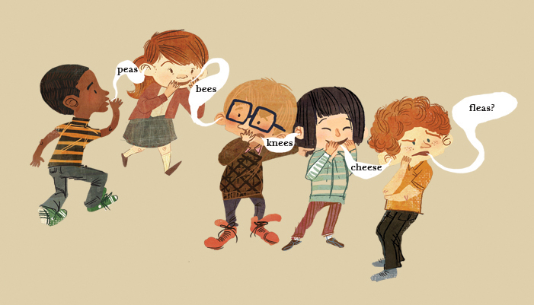
Language Does Matter

Slide 18
Language … Translations, Meaning
“Present payment, identify payment type and then accept cash or accept credit card and then, if approved, prepare delivery”
English

Slide 19
Language … Translations, Meaning, Cont..
De pago actual, identificar el tipo de pago y luego aceptar dinero en efectivo o aceptan tarjetas de crédito y luego, si es aprobado, preparar la entrega
Spanish
Amb suplement actual, identificar el tipus de pagament i després acceptar diners en efectiu o accepten targetes de crèdit i després, si és aprovat, preparar el lliurament
Catalan

Slide 20
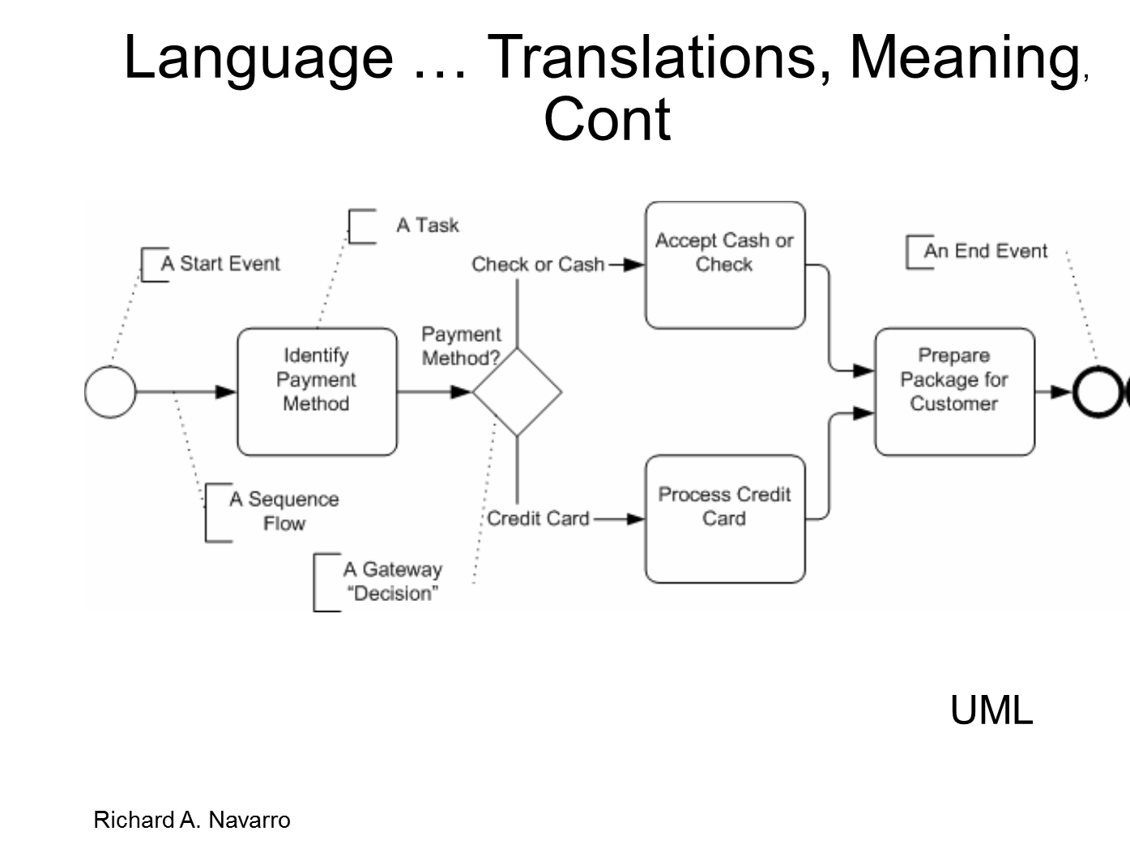
Grady Booch, James Rumbaugh, Ivar Jacobson, and the Rational Software Corporation

Slide 21
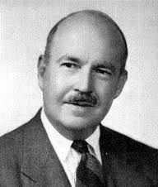
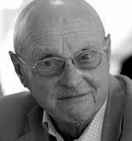
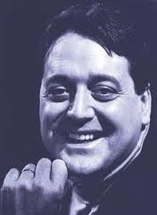
Cultures ARE Different
Parsons
Hofstede
Trompenaars

Slide 22
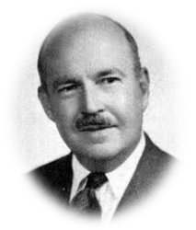
Cultures are different …. Talcott Parsons
Talcott Parsons (December 13, 1902 – May 8, 1979) was an American sociologist of the classical tradition, best known for his social action theory and structural functionalism. Parsons is considered one of the most influential figures in the development of sociology in the 20th century.
Wikipedia

Slide 23

Talcott Parsons
Parsons suggested a framework for addressing those elements that deal with how people relate to each other.
  Universalism vs. Particularism
  Individualism vs. Communitarism
  Neutral vs. Emotional
  Specific vs. Diffuse
  Achievement vs. Ascription
Parsons, T … The Social System, Free Press, New York, 1951

Slide 24
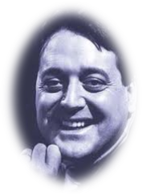
Cultures are Different …. Fons Trompenaars
Alfonsus Fons Trompenaars (born 1953, Amsterdam) is a Dutch-French organizational theorist, management consultant, and author in the field of cross-cultural communication, known for the development of Trompenaars' model of national culture differences.

Slide 25
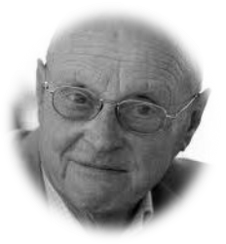
Cultures are Different … Geert Hofstede
Gerard Hendrik (Geert) Hofstede (born 2 October 1928) is a Dutch social psychologist, former IBM employee, and Professor Emeritus of Organizational Anthropology and International Management at Maastricht University in the Netherlands, well known for his pioneering research on cross-cultural groups and organizations.

Slide 26
Cultures are Different …. Geert Hofstede
Hofstede defined four major cultural domains to characterize people’s attitudes and behaviors
Spoiler Alert … These thoughts ought to be considered as guides … not absolutes … they are a way to think about and understand inter-cultural relationships … they are NOT hard and fast rules
Universalism vs Collectivism
Uncertainty Avoidance
Masculinity vs Feminism
Power Distance
Two other “domains” have been subsequently defined

Slide 27
Individualism vs Collectivism
“ Individualism can be defined as a preference for a loosely-knit social framework in which individuals are expected to take care of only themselves and their immediate families.
“ Collectivism represents a preference for a tightly-knit framework in society in which individuals can expect their relatives or members of a particular in-group to look after them in exchange for unquestioning loyalty. A society's position on this dimension is reflected in whether people’s self-image is defined in terms of “I” or “we.””
Gerte Hofstede Institute

Slide 28

Individualism vs Collectivism
Consider this …
One of your employees has put too much salt into a batch of beer ..
  What do you, as a manager, do?
In a Collectivist culture?
In an Individualist culture?

Slide 29
Uncertainty Avoidance
“The Uncertainty Avoidance dimension expresses the degree to which the members of a society feel uncomfortable with uncertainty and ambiguity. The fundamental issue here is how a society deals with the fact that the future can never be known: should we try to control the future or just let it happen? Countries exhibiting strong UAI maintain rigid codes of belief and behavior and are intolerant of unorthodox behavior and ideas. Weak UAI societies maintain a more relaxed attitude in which practice counts more than principles.”
Gerte Hofstede Institute

Slide 30

Uncertainty Avoidance
Consider this …
You are presented with a new business opportunity … but while there is a high profit opportunity nothing like this has ever been done before
  What do you, as a manager, do?
In a Risk Tolerant culture?
In a Risk Adverse culture?

Slide 31
Masculinity vs Feminism
“The Masculinity side of this dimension represents a preference in society for achievement, heroism, assertiveness and material rewards for success. Society at large is more competitive. Its opposite, femininity, stands for a preference for cooperation, modesty, caring for the weak and quality of life. Society at large is more consensus-oriented. In the business context Masculinity versus Femininity is sometimes also related to as "tough versus tender" cultures.”
Gerte Hofstede Institute

Slide 32
Masculinity vs Feminism
Consider This …
You are presented with a new business opportunity … your firm is considering opening a branches in highly diverse cultures … some fundamentally nurturing and some aggressive
  What do you, as an executive, do?
  How do you design your services and systems?

Slide 33
Power Distance
“The Power Distance dimension expresses the degree to which the less powerful members of a society accept and expect that power is distributed unequally. The fundamental issue here is how a society handles inequalities among people. People in societies exhibiting a large degree of Power Distance accept a hierarchical order in which everybody has a place and which needs no further justification. In societies with low Power Distance, people strive to equalize the distribution of power and demand justification for inequalities of power.”
Gerte Hofstede Institute

Slide 34

Power Distance
Consider This …
You are charged with establishing a new branch office in a “foreign” country … your corporate culture values all its employees and their thoughts, ideas, and inputs
  How might you design the organization in a High Power Distance culture?
  In a Low Power Distance culture?

Slide 35
Systems Analysis / Requirements
Requirements Elicitation is, fundamentally, a communications- and understanding- based process
  One person ( the expert or respondent ) communicates knowledge and understanding to another ( the Systems Analyst or Requirements Elicitator)
  The Systems Analyst documents that knowledge and creates a set of requirements on which a system will be based

Slide 36
Systems Analysis … Requirements Elicitation
Data and Document oriented techniques
Individual oriented techniques
  From interviews to ethnography and repertory grids
Group oriented techniques
  From Focus Groups to Prototyping

Slide 37

Systems Analysis … Requirements Elicitation
Data and Document oriented techniques
Review of requirements documents, et.al.

Slide 38

Systems Analysis / Requirements
Individual Oriented Techniques
  Interviews
  Open-Ended Interviews
  Structured Interviews
  Surveys
  Contextual Inquiry
  Concept Elicitation

Slide 39
Systems Analysis / Requirements
Concept Elicitation … Protocol Analysis
A systems analysis technique that has a respondent describe and explain actions

Slide 40
Systems Analysis / Requirements Elicitation
Concept Elicitation … Repertory Grids
An interviewing technique that uses factor analysis to elicit respondents’ true feelings and beliefs about complex scenarios
Useful in unearthing tacit knowledge

Slide 41
Systems Analysis / Requirements Elicitation
Contextual Inquiry
Methods based on ethnography and/or discourse analysis
Methods that are based on the analysts becoming immersed in and therefore gaining deep understanding of a scenario

Slide 42
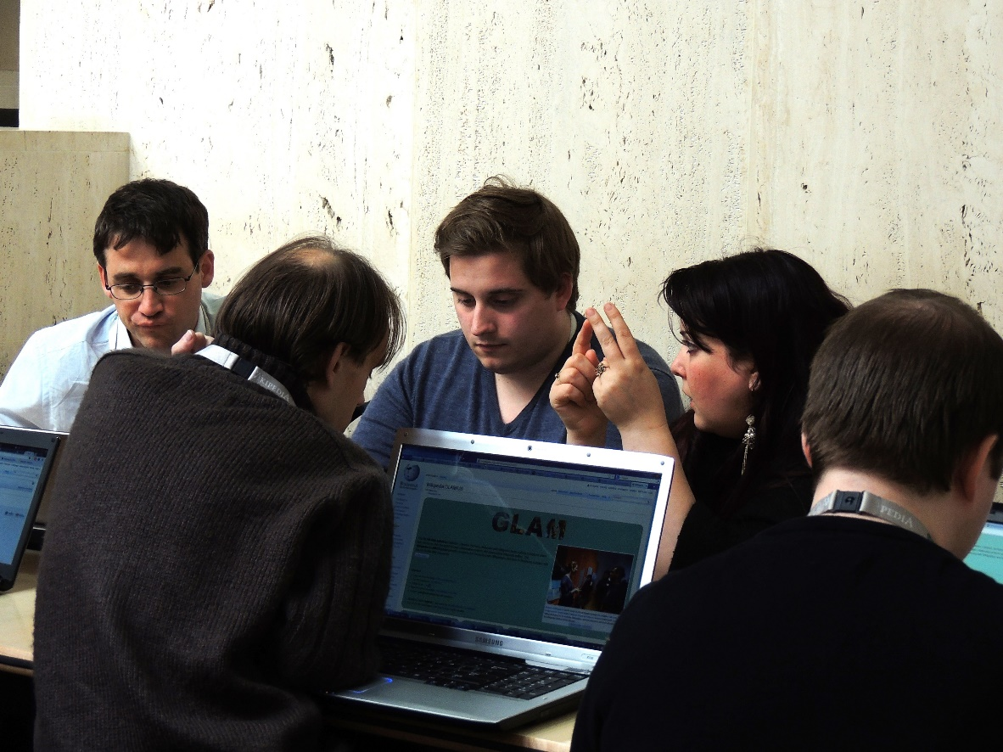
Systems Analysis / Requirements
Group Oriented Techniques
  Focus Groups
  Delphi Methods
  RAD / JAD Teams
  Prototyping

Slide 43
Systems Analysis / Requirements
Delphi Methods
Piecewise refinement of questionnaire or survey instrument based on responses of experts working remotely and asynchronously

Slide 44
Systems Analysis / Requirements
Prototyping
“Prototyping is an integral part of design in general because it allows us to test our ideas quickly and improve on them in an equally timely fashion. The Institute of Design at Stanford encourages a “bias towards action”, where building and testing is valued over thinking and meeting.”
https://www.interaction-design.org/literature/article/design-thinking-get-started-with-prototyping

Slide 45
Systems Analysis / Requirements Elicitation … The Challenges … The Mountains to be Climbed
Requirements Elicitation / Systems Analysis ought to match processes to Culture and Language Challenges

Slide 46
Systems Analysis / Requirements Elicitation … The Challenges … The Mountains to be Climbed
Linguistics Related Challenges
Culture Related Challenges

Slide 47
Requirements Elicitation … Language Related Challenges
Language Does Influence Thought
Language Does Influence Understanding
  Issues Include
    Behaviors and Beliefs
    Fundamental meanings
    Translations
Language Related Challenges

Slide 48
Requirements Elicitation … Language Related Challenges
Language
Linguistic relativity
Imperfections in Translation
Contextual differences
Colloquialisms and slang
Language Related Challenges

Slide 49
Linguistics Related Challenges
Language Related Challenges
Language and Linguistics - Potential Strategies …
  Use native speakers
  Use back translations
  Use triangulation
  Use examples and anchors
  Avoid slang, colloquial terms, overly complicated jargon
Linguistic relativity
Imperfections in Translation
Contextual differences
Colloquialisms and slang

Slide 50
Requirements Elicitation … Culture Related Challenges
Culture Does Influence Thought
Culture Does Influence Understanding
  Issues Include
    Power Distance
    Individualism / Collectivism
    Uncertainty Avoidance
Culture Related Challenges

Slide 51
Requirements Elicitation … Power Distance Related Challenges
Power Distance Challenges
High Power Distance respondents may be reluctant to offer opinions contrary to their superiors
Culture Related Challenges
The Systems Analyst must understand how a culture’s tendency towards Power Distance will impact the elicitation process

Slide 52
Culture Related Challenges …
Power Distance Related Challenges
Power Distance - Potential Strategies …
  Ensure that respondents believe that all inputs will be anonymous
  Use Delphi methods
  Use contextual analysis techniques, including ethnographic or discourse analysis methods
Culture Related Challenges
Power Distance

Slide 53
Culture Related Challenges …
Power Distance Related Challenges
Power Distance - Potential Strategies ( Cont. )…
  Use Concept elicitation techniques including protocol analysis and repertory grids
  Be patient … approvals may need to be obtained
Culture Related Challenges
Power Distance

Slide 54
Requirements Elicitation … Uncertainty Avoidance Related Challenges
Uncertainty Avoidance Challenges
High-Uncertainty Avoidance respondents may be reluctant to offer opinions that seem to impose extra risk
Low-Uncertainty Avoidance respondents may be inclined to take risk for risk’s sake
Culture Related Challenges
The Systems Analysts must understand how a culture’s tendency towards Uncertainty Avoidance will impact the elicitation process

Slide 55
Culture Related Challenges …
Uncertainty Avoidance Related Challenges
Uncertainty Avoidance - Potential Strategies
  Use leading or closed end questions to encourage respondent to enter into uncomfortable areas
  Use Contextual Inquiry to more fully understand situations
Culture Related Challenges
Uncertainty Avoidance

Slide 56
Requirements Elicitation … Individualism Related Challenges
Individualism vs Collectivism Challenges
Collectivism oriented respondents may be reluctant to offer opinions contrary to the view of the group to which they belong
Individualism-oriented respondents may engage behavior that will enhance his own position
Culture Related Challenges
  The Systems Analyst must understand how a culture’s tendency towards Individualism / Collectivism will impact the elicitation process

Slide 57
Culture Related Challenges …
Individualism Related Challenges
Individualism vs Collectivism - Potential Strategies …
  Use Action methods such as prototyping
  Avoid group methods such as focus groups for high-collectivism respondents
  Use Concept Elicitation techniques to better understand group dynamics
Culture Related Challenges
Individualism vs Collectivism

Slide 58

Class Discussion
Working in groups, consider …
  You are responsible for a major multi-national systems analysis project
    You realize cultural variations may impact how you gather and interpret / analyze systems requirements.
    Which cultural dimension ought you consider?
      Why?
      How?

Slide 59
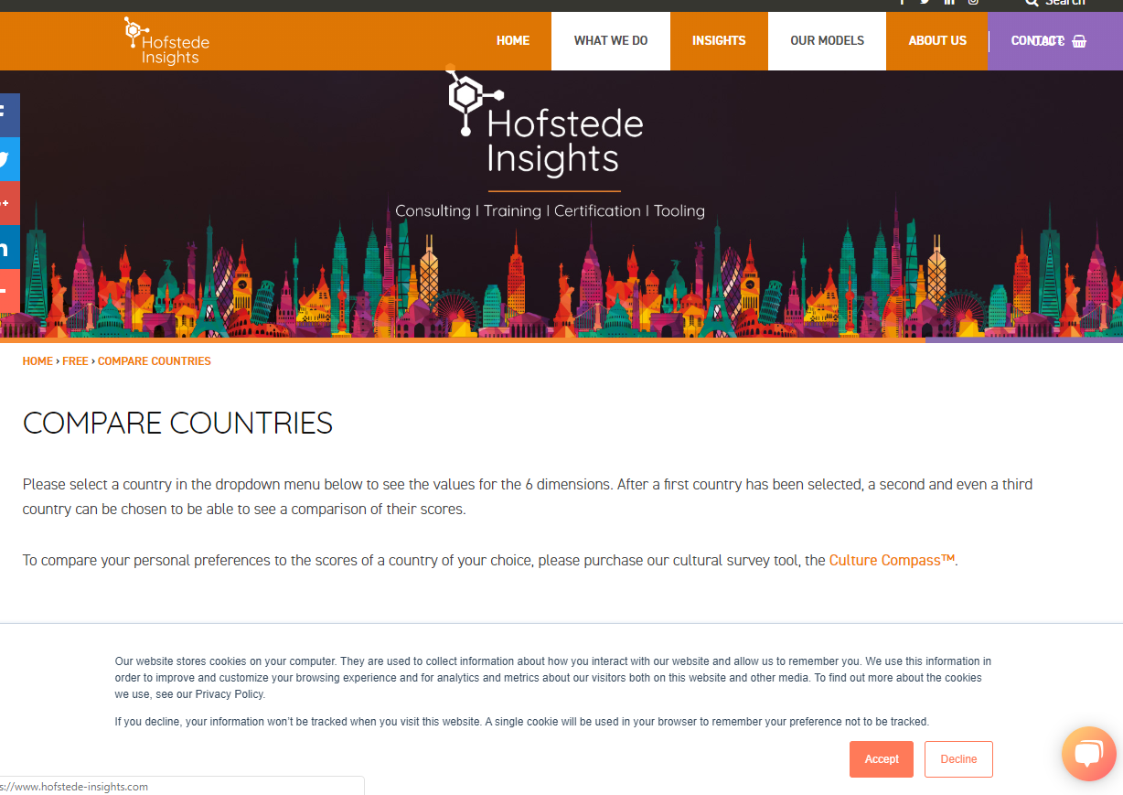
Hofsted Institute https://www.hofstede-insights.com/product/compare-countries/
Working in groups, consider
  You are responsible for a major multi-national systems analysis project
    You realize cultural variations may impact how you gather and interpret / analyze systems requirements.
    Which cultural dimension ought you consider?
      Why?
      How?

Slide 60

Systems Analysis / Requirements Elicitation … There are Challenges … There are Mountains to be Climbed
Knowledge of culture and language- influences will help you as you climb

